Slide 1
Building an Application on your Project
Dec-2023

Slide 2
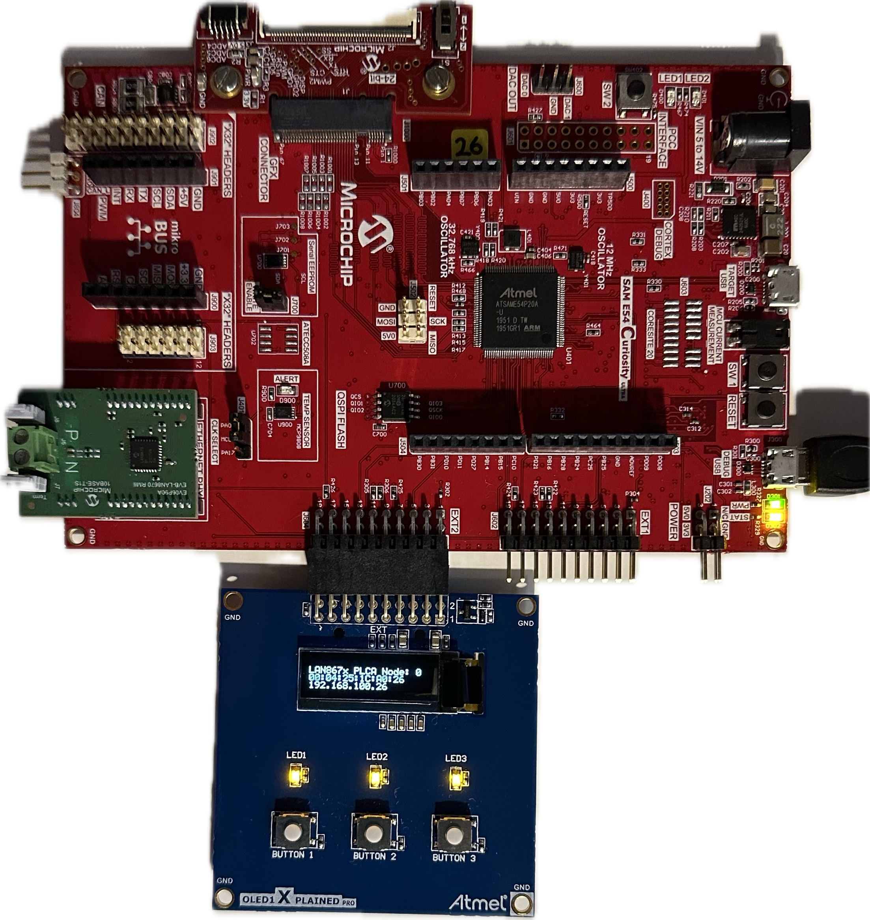
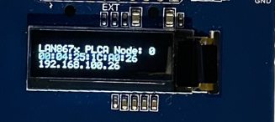
OLED Integration with 10BASE-T1S
The project presented here will enable the addition of a display to the hardware setup
This will be useful for inspecting the IP address, MAC address and PLCA Node ID of each board.
OLED1 Xplained Pro - SSD1306

Slide 3
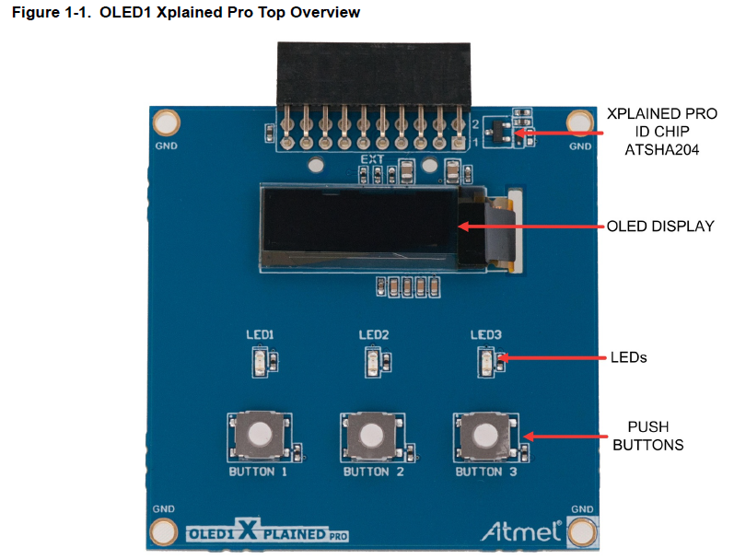
OLED1 Overview
The OLED display is driven by the SSD1306 controller, which takes input in SPI format and converts it to 8 bit parallel to drive the display itself.
The ATSAME54 will need to have an SPI interface driver to send data to this bus
We will add this in Harmony, and also the applicable driver for the controller
We will then write a simple application that will send the IP Address, MAC Address and PLCA Node ID to the display

Slide 4
OLED1 Overview
SPI (MOSI, SCK, SS)
DATA_CMD_SEL
The ATSAME54 will need to configure the pins to drive and receive input from the OLED1 Xplained board
SPI is sent from the driver on the ATSAME54 to the controller
DATA_CMD_SEL tells the controller if the SPI traffic is data for the display, or configuration information
DISPLAY_RESET resets the controller
LED 1,2,3 are driven from the ATSAME54 to the LEDs, and are active low
BUTTON 1,2,3 are inputs from the OLED1 Explained board to the ATSAME54, and will be configured as input pins on the ATSAME54
DISPLAY_RESET
LED 1,2,3
BUTTON 1,2,3

Slide 5
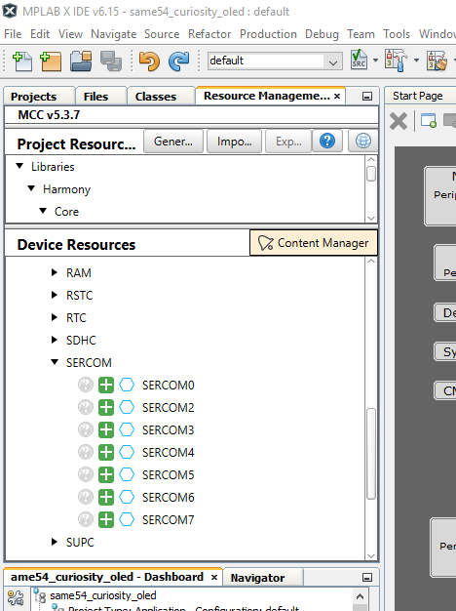
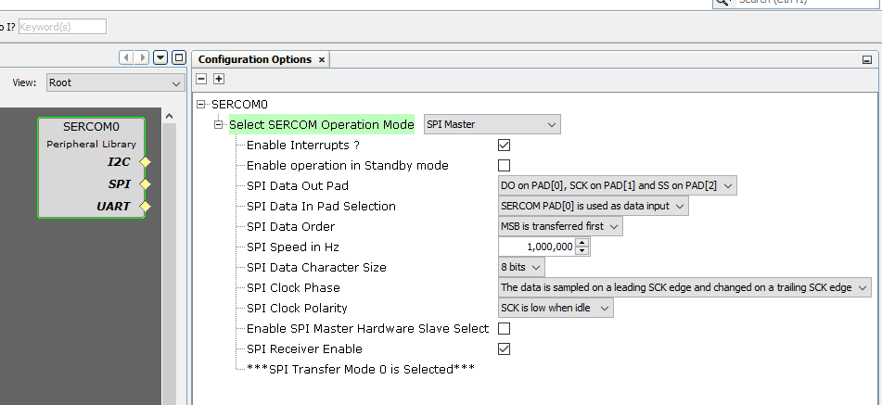
Adding the SPI Device to your 10BaseT1S Project
In Device Resources, use the + symbol beside SERCOM0 to add it to the project
In the Project Graph, select the SERCOM0 component and configure it as SPI Master

Slide 6
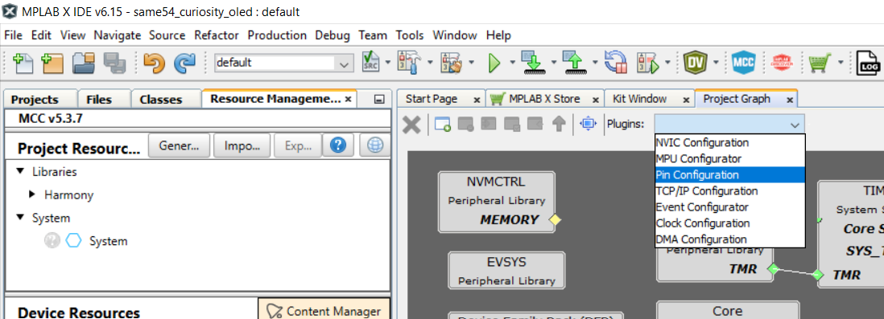
Use the Pin Configuration Tool to set up the pins for the OLED Xplained board
As before, we will use the Pin Configuration tool to set up the extra pins that are needed
Note : the names used here need to be added, as they are used by the code in the application to refer to the configured pins

Slide 7
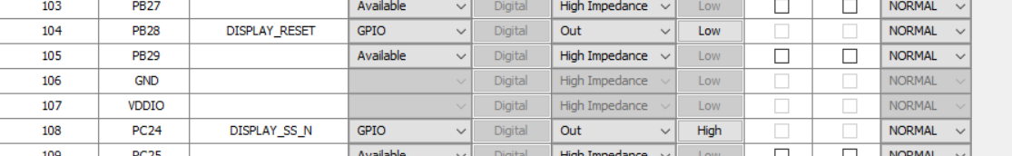
Configure Pins
Pay attention to the Direction and Pull Up/Pull Down details, so that these pins are enabled with the correct functionality
Note : the names used here need to be added, as they are used by the code in the application to refer to the configured pins

Slide 8
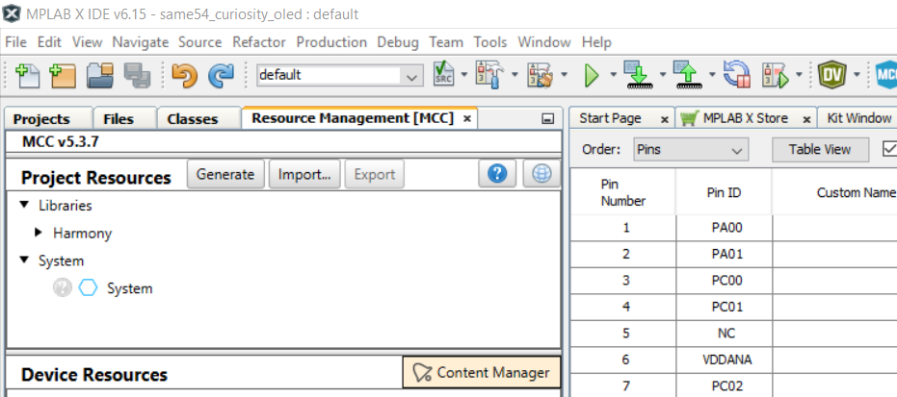
Regenerate the Code
Use the Generate button to re-generate the code

Slide 9
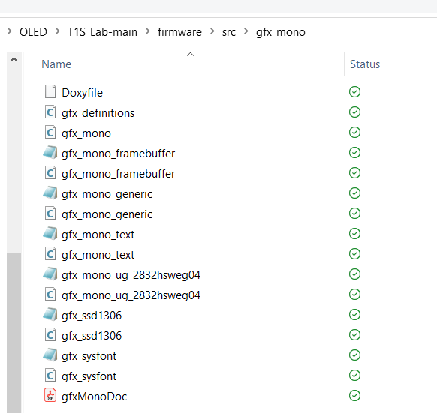
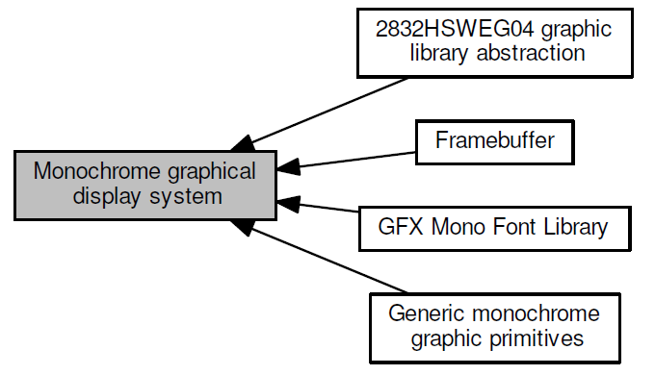
Importing the graphics libraries into the project
The graphics library files need to be copied over from the pre-prepared project, you can download them in the next few steps, from the memory stick
These files are also available from Github:
https://github.com/zabooh/T1S_Lab.git
=> firmware/src/gfx_mono

Slide 10
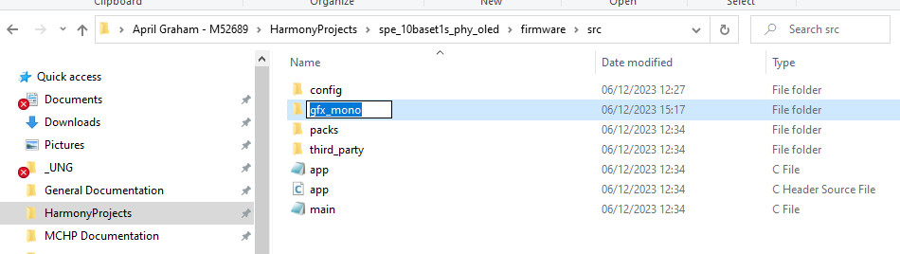
Copy over Files with Windows Explorer
Step 1: Navigate using Windows Explorer to where you have created your project
Descend into the src directory and create a folder named gfx_mono
From the example project, copy in the files for the graphics library into this folder
Copy

Slide 11
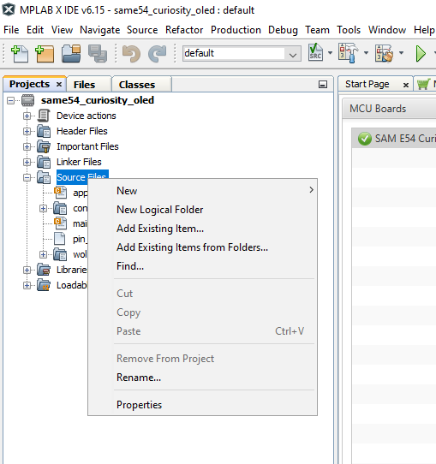
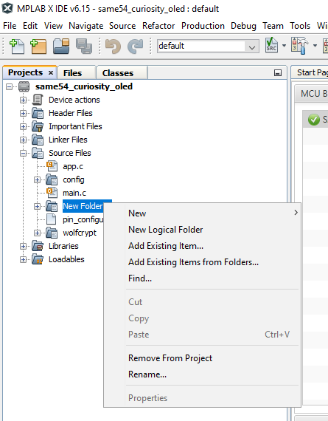
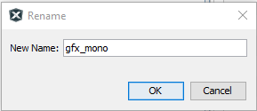
Add the files to the Project in MPLAB X
In MPLAB X, the graphics library files need to be added to the project.
To do this, create a “Logical Folder” within your project
Rename it to “gfx_mono”
Then add the files to this project
This tells MPLAB X that these files are part of the project and will be included in the compilation and build
Right click
and rename
Right click

Slide 12
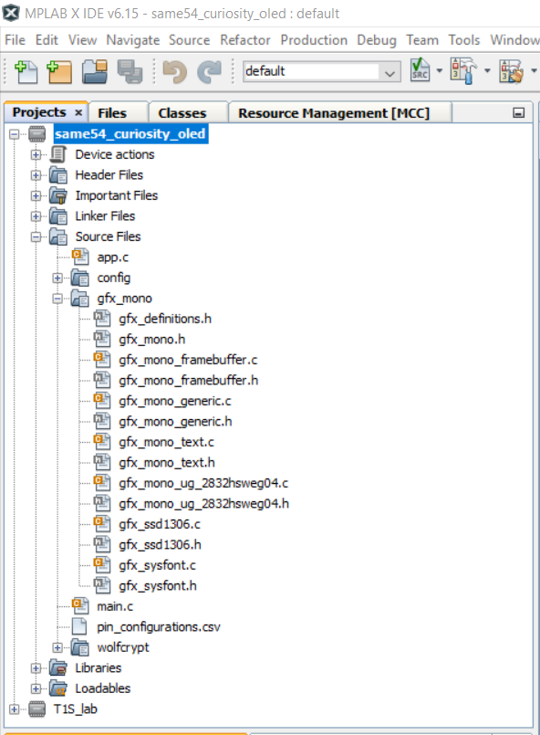
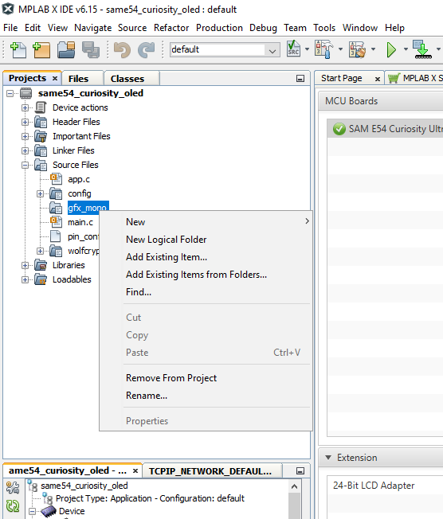
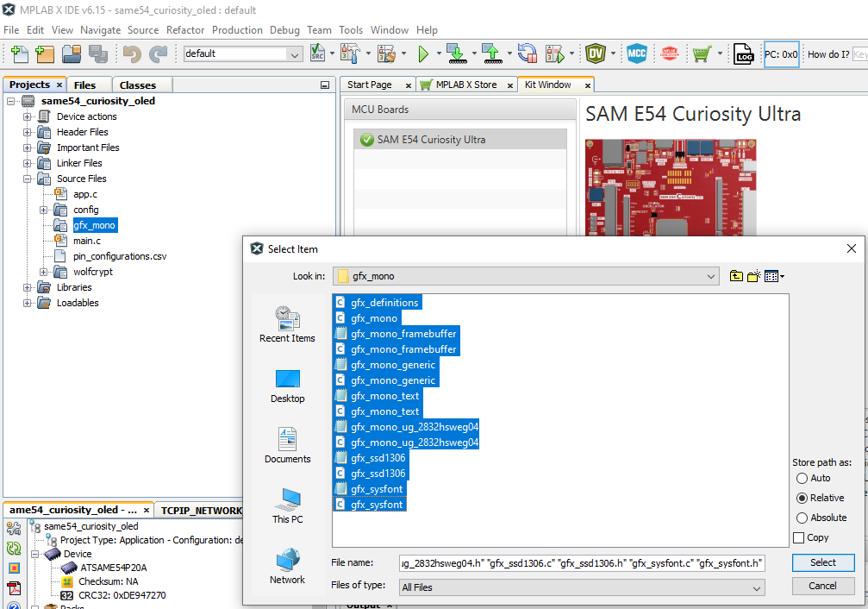
Add the files to the Project in MPLAB X (contd)
Then add the files to this project
This tells MPLAB X that these files are part of the project and will be included in the compilation and build
Check in the project folder in MPLAB X that the files were added correctly:
Right click

Slide 13
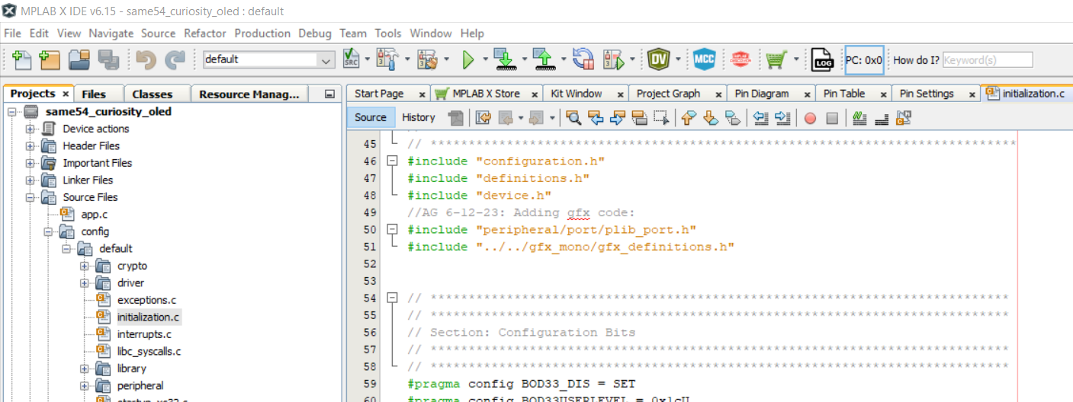
Add the Code for the gfx_mono Initialization
In initialization.c add includes add the top
#include "peripheral/port/plib_port.h"
#include "../../gfx_mono/gfx_definitions.h"
Double
click

Slide 14
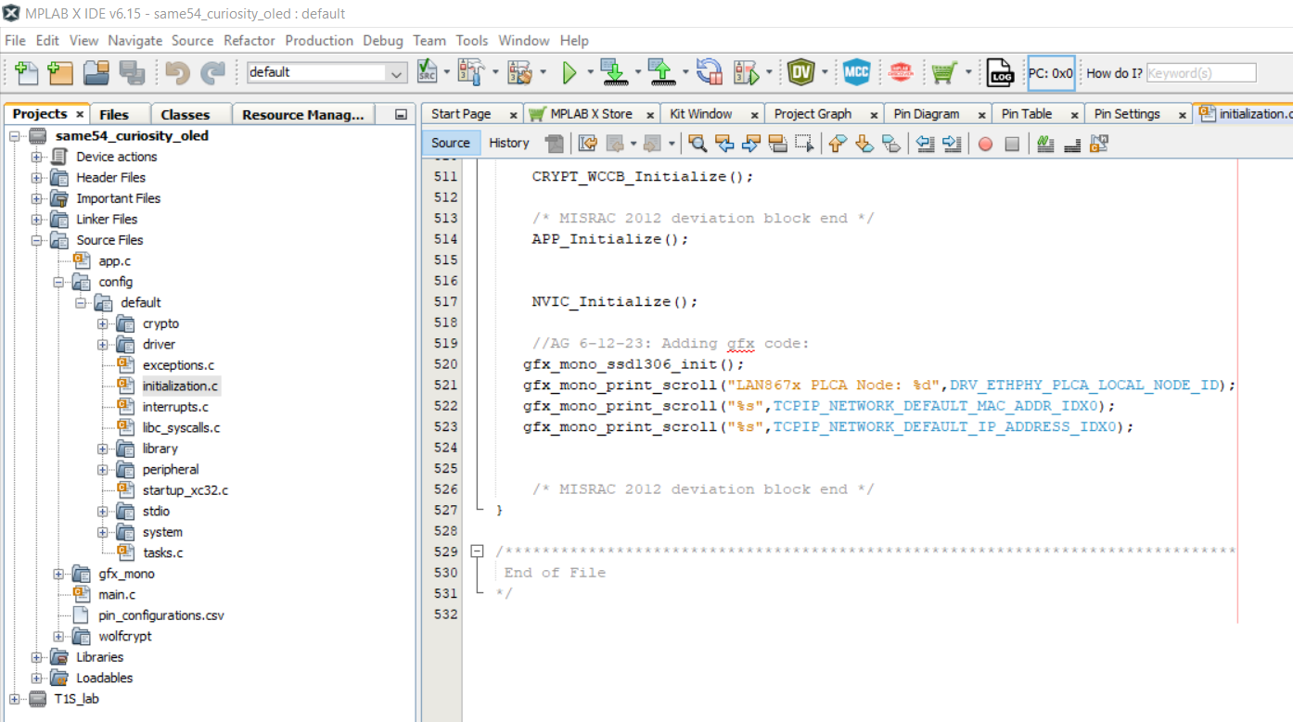
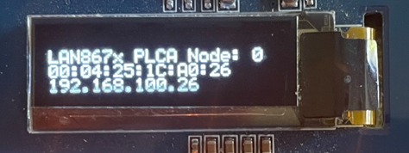
Add the Code for the gfx_mono Initialization
In initialization.c add code at the end of SYS_Initialize() :
void SYS_Initialize ( void* data )
{
...
...
APP_Initialize();
NVIC_Initialize();
gfx_mono_ssd1306_init();
gfx_mono_print_scroll("LAN867x PLCA Node: %d",DRV_ETHPHY_PLCA_LOCAL_NODE_ID);
gfx_mono_print_scroll("%s",TCPIP_NETWORK_DEFAULT_MAC_ADDR_IDX0);
gfx_mono_print_scroll("%s",TCPIP_NETWORK_DEFAULT_IP_ADDRESS_IDX0);
}

Slide 15
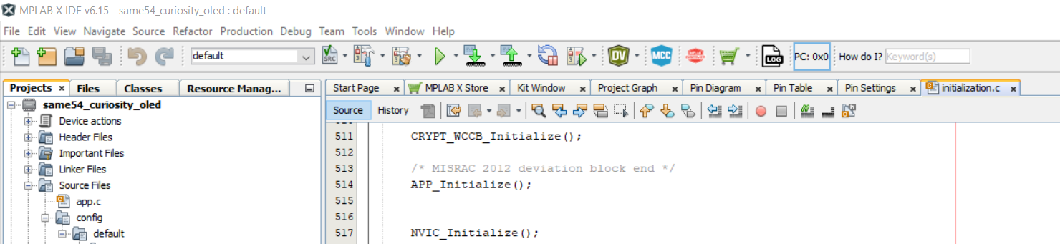

Next step...program the boards
Clean and Build Project (1) , than Program the first board (2):
After this, program the second board – but don't forget to change the MAC and IP address, along with the PLCA Node ID in configuration.h (as before) before you program the second board.
Run out of time? Just use the project "T1S_lab.X" in the download and use this to program your boards.
1
2

Slide 16
Result
The OLED will now show the IP Address, MAC Address and PLCA Node ID for each board
OLED1 Xplained Pro - SSD1306

Slide 17
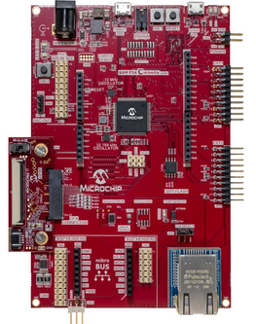
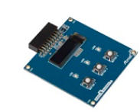
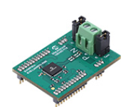
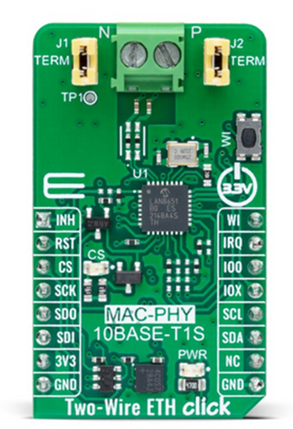
Links to Hardware
Evaluation Board | Link | Photo
SAM E54 CURIOSITY ULTRA DEVELOPMENT BOARD | https://www.microchipdirect.com/dev-tools/DM320210
ATOLED1-XPRO - OLED1 Xplained Pro extension kit | https://www.microchipdirect.com/dev-tools/ATOLED1-XPRO
EVB-LAN8670-RMII | https://www.microchipdirect.com/dev-tools/EV06P90A
Two Wire Click (Mikroe MAC-PHY Clickboard) | https://www.mikroe.com/two-wire-eth-click

